Slide 1
Introducing Git version control into your team
Amirreza Amouie
aamouie01@gmail.com
@theamouie

Slide 2
Before we start…
Install Git.
Make a Github account (if you don’t already have.)
Write down your email addresses which you made your account with on the paper.

Slide 3

WHO MADE THESE?
Mark Groves
- A Program manager @ Microsoft
Notes:
My name is Mark Groves and I am a Program manager within Developer Division

Slide 4
Agenda
What is Git? (Mark Groves)
Git 101 (Mark Groves)
Branches Demystified (Paolo Perrotta)
Distributed Version Control (Paolo Perrotta)
Tools/Resources
Notes:
Today we I’m going to talk through several core concepts within Git. How you can take advantage of it within your team. And a few powerful scenarios such as using git to handle deployments.

Slide 5
History

Slide 6
History
Created by Linus Torvalds for work on the Linux kernel ~2005
Notes:
Git was originally created by Linus for work on the Linux kernel right around 2005.
Although git has its origins in the Open source community, git is being used within close source projects also.

Slide 7





History
Created by Linus Torvalds for work on the Linux kernel ~2005
Some of the companies that use git:
Notes:
Git was originally created by Linus for work on the Linux kernel right around 2005.
Although git has its origins in the Open source community, git is being used within close source projects also.
This is just some of the many companies that are using git for both oss and closed sourced projects.

Slide 8
What is Git?

Slide 9
Git is a
Distributed
Version Control System
Notes:
Git is a distributed version control system.

Slide 10
OR
Notes:
Or you can think of it as

Slide 11
Git is a
Directory
Content Management System
Notes:
A directory content management system

Slide 12
Git is a
Tree
history storage system
Notes:
A tree based history storage system

Slide 13
Git is a
Stupid
content tracker
Notes:
Or How git is described on the Git Man page a Stupid content tracker.

Slide 14
How ever you think about it…

Slide 15
How ever you think about it…
Git is SUPER cool
Notes:
Git is super cool.

Slide 16
Distributed
Everyone has the complete history
Notes:
So what does it really mean to have a distributed version control system?
Everyone on your team has a complete history of the code locally.

Slide 17
Distributed
Everyone has the complete history
Everything is done offline
…except push/pull
Notes:
Just about everything in Git can be done offline.
Not just that the system works well when it is offline. It is design from the beginning to have no real dependencies on a specific server.
The only actions you do in git where you need a server is when you push or pull changes from other team members.

Slide 18
Distributed
Everyone has the complete history
Everything is done offline
No central authority
…except by convention
Notes:
In git there is no central server required. So the authority is really determined by the conventions your team puts in place.

Slide 19
Distributed
Everyone has the complete history
Everything is done offline
No central authority
Changes can be shared without a server
Notes:
Given Git’s nature you can even share changes in a peer-to –peer nature.
This does not happen often but Git does enable this ability. If your server is offline for some reason your team can still work.

Slide 20
Centralized VC vs. Distributed VC
Central Server
Remote Server
Notes:
This is over simplifying the story, but the basics are that centralized version control system define a central authority.
I am not saying one system is better that the other, it is just that each model that its benefits.
In the distributed model by definition everything is expected to be off line. To have a system that expects everything to be offline, you have to build in several local capabilities that are not required in a centralized model.
Such as local branching. And to make branching fast and lightweight you better make merging great also.
I won’t go into the guts of git that enables some of this capability in this talk, but if you are interested I will highlight some resources at the end of the talk where you can go deeper.

Slide 21
Branching
Notes:
Ok lets get into branching.

Slide 22
Branching
Forget what you know from Central VC
(…TFS, SVN, Perforce...)
Notes:
For this you need to forget what your experiences with branching in centralized version control systems.

Slide 23
Branching
Forget what you know from Central VC
Git branch is “Sticky Note” on a graph node
Notes:
A Git branch is just a sticky note on the graph.

Slide 24
Branching
Forget what you know from Central VC
Git branch is “Sticky Note” on a graph node
All branch work takes place within the same folder within your file system.
Notes:
All work happens within this one location.
When I first started using Git, it really freaked me out when I switched branches for the first time and things just disappeared.
It took me awhile to really trust what was happening. So don’t freak out it is ok.

Slide 25
Branching
Forget what you know from Central VC
Git branch is “Sticky Note” on the graph
All branch work takes place within the same folder within your file system.
When you switch branches you are moving the “Sticky Note”
Notes:
Switching between branches is just moving the sticky note around.

Slide 26
Initialization
C:\> mkdir CoolProject
C:\> cd CoolProject
C:\CoolProject > git init
Initialized empty Git repository in C:/CoolProject/.git
C:\CoolProject > notepad README.txt
C:\CoolProject > git add .
C:\CoolProject > git commit -m 'my first commit'
[master (root-commit) 7106a52] my first commit
1 file changed, 1 insertion(+)
create mode 100644 README.txt
Notes:
After you install git on your machine to get started you will need to initialize a repository.
You can do this by going into your file system, creating a folder and doing git init within the folder.
All the magic happens in the Dot Git folder. This folder IS GIT. You can copy this folder to another machine and it will work.
When I first started playing with git, I had setup a new machine, and was having a hell of a time trying to figure out how I should move my git projects over to the new machine. It was kind of embarrassing. Eventually I just tried to copy it over and it worked.
At this point you really don’t have much. You need to do your first commit to make this light up.
You create a file. When then stage it, but telling git the track this file. In this case I told git to add all files.
Then I was able to commit with a message say this is my first commit.

Slide 27
Branches Illustrated
master
A
> git commit –m ‘my first commit’
Notes:
Now lets see what this visually looks like.
On my first commit I have A.
The default branch that gets created with git is a branch names Master.
This is just a default name. As I mentioned before, most everything in git is done by convention. Master does not mean anything special to git.

Slide 28
Branches Illustrated
master
A
B
C
> git commit (x2)
Notes:
We make a set of commits, moving master and our current pointer (*) along

Slide 29
Branches Illustrated
master
A
B
C
bug123
> git checkout –b bug123
Notes:
Suppose we want to work on a bug. We start by creating a local “story branch” for this work.
Notice that the new branch is really just a pointer to the same commit (C) but our current pointer (*) is moved.

Slide 30
Branches Illustrated
master
A
B
C
D
E
bug123
> git commit (x2)
Notes:
Now we make commits and they move along, with the branch and current pointer following along.

Slide 31
Branches Illustrated
master
A
B
C
D
E
bug123
> git checkout master
Notes:
We can “checkout” to go back to the master branch.
This is where I was freaked out the first time I did this. My IDE removed the changes I just made. It can be pretty startling, but don’t worry you didn’t lose anything.

Slide 32
Branches Illustrated
master
A
B
C
D
E
bug123
> git merge bug123
Notes:
And then merge from the story branch, bringing those change histories together.

Slide 33
Branches Illustrated
master
A
B
C
D
E
> git branch -d bug123
Notes:
And since we’re done with the story branch, we can delete it. This all happened locally, without affecting anyone upstream.

Slide 34
Branches Illustrated
master
A
B
C
D
E
F
G
bug456
Notes:
Let’s consider another scenario. Here we created our bug story branch back off of (C). But some changes have happened in master (bug 123 which we just merged) since then.
And we made a couple of commits in bug 456.

Slide 35
Branches Illustrated
master
A
B
C
D
E
F
G
bug456
> git checkout master
Notes:
Again, to merge, we checkout back to master which moves our (*) pointer.

Slide 36
Branches Illustrated
master
A
B
C
D
E
H
F
G
bug456
> git merge bug456
Notes:
And now we merge, connecting the new (H) to both (E) and (G). Note that this merge, especially if there are conflicts, can be unpleasant to perform.

Slide 37
Branches Illustrated
master
A
B
C
D
E
H
F
G
> git branch -d bug456
Notes:
Now we delete the branch pointer.
But notice the structure we have now. This is very non-linear. That will make it challenging to see the changes independently. And it can get very messy over time.

Slide 38
Branches Illustrated
master
A
B
C
D
E
F
G
bug456
Notes:
Rebase flow - Let’s go back in time and look at another approach that git enables. So here we are ready to merge.

Slide 39
Branches Illustrated
master
A
B
C
D
E
F’
G’
bug456
> git rebase master
Notes:
Instead of merging, we “rebase”.
What this means is something like this:
1. Take the changes we had made against (C) and undo them, but remember what they were
2. Re-apply them on (E) instead

Slide 40
Branches Illustrated
master
A
B
C
D
E
F’
G’
bug456
> git checkout master
> git merge bug456
Notes:
Now when we merge them, we get a nice linear flow.
Also, the actual changeset ordering in the repository mirrors what actually happened. (F’) and (G’) come after E rather than in parallel to it. Also, there is one fewer snapshots in the repository.

Slide 41
Branching Review

Slide 42
Branching Review
Quick and Easy to create ‘Feature’ Branches

Slide 43
Branching Review
Quick and Easy to create ‘Feature’ Branches
Local branches are very powerful

Slide 44
Branching Review
Quick and Easy to create ‘Feature’ Branches
Local branches are very powerful
Rebase is not scary

Slide 45
Tools / Resources
Learn interactively: http://try.github.io/
Git Cheatsheet: https://goo.gl/E4Jvbn
README file template: https://goo.gl/k5nwE1

Slide 46
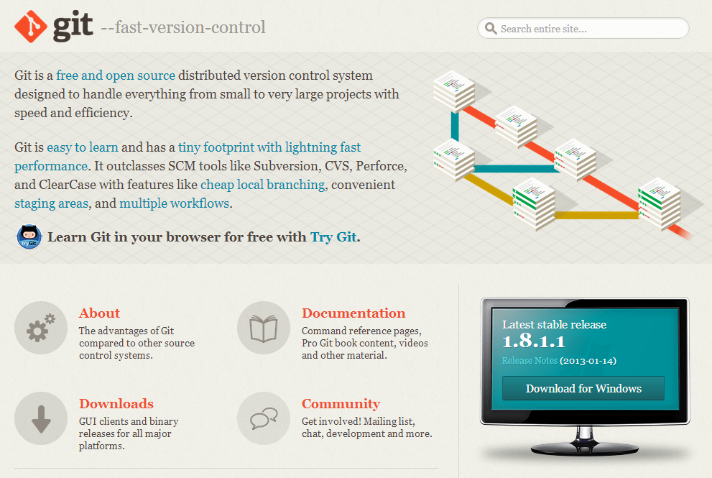
http://Git-SCM.com

Slide 47
Tools / Resources
Pro Git (Book) http://www.git-scm.com/book
TortoiseGit (with TortoiseMerge) http://code.google.com/p/tortoisegit
Msysgit (includes git-bash) http://code.google.com/p/msysgit
Posh-Git (for PowerShell users) http://github.com/dahlbyk/posh-git
GitScc (Visual Studio integration) http://gitscc.codeplex.com/
Windows Git Credential Store http://gitcredentialstore.codeplex.com/
GitHub for Windows http://windows.github.com/

Slide 48
Make a github account.

Slide 49
Tip:
Always use “git status”

Slide 50
Scenario A
1) Make a repo
2) Commit a readme file
3) Push
4) Change the readme in the Github website
5) Make a new branch
6) Make a new file
7) Push on the branch
8) Merge to master in Github

Slide 51
Scenario B
https://github.com/theamouie/cesa-git-workshop
(I’ll put the slides in this repo after the workshop)

Slide 52
_{Thanks!}

